Slide 1


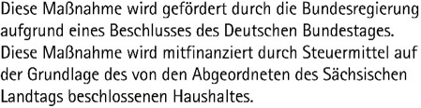
Data Science and AI for Medicine Training School
TRAINING: Introduction to Deep Learning
SPEAKER: Laura Zigutyte, Michaela Unger

Slide 2
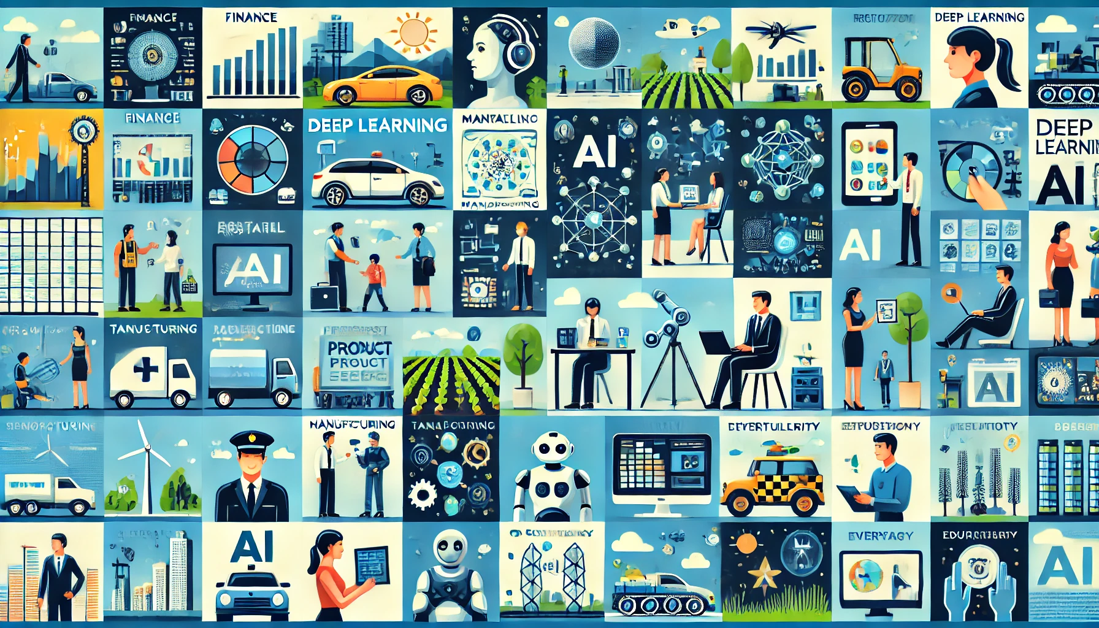
Deep Learning is everywhere

Slide 3
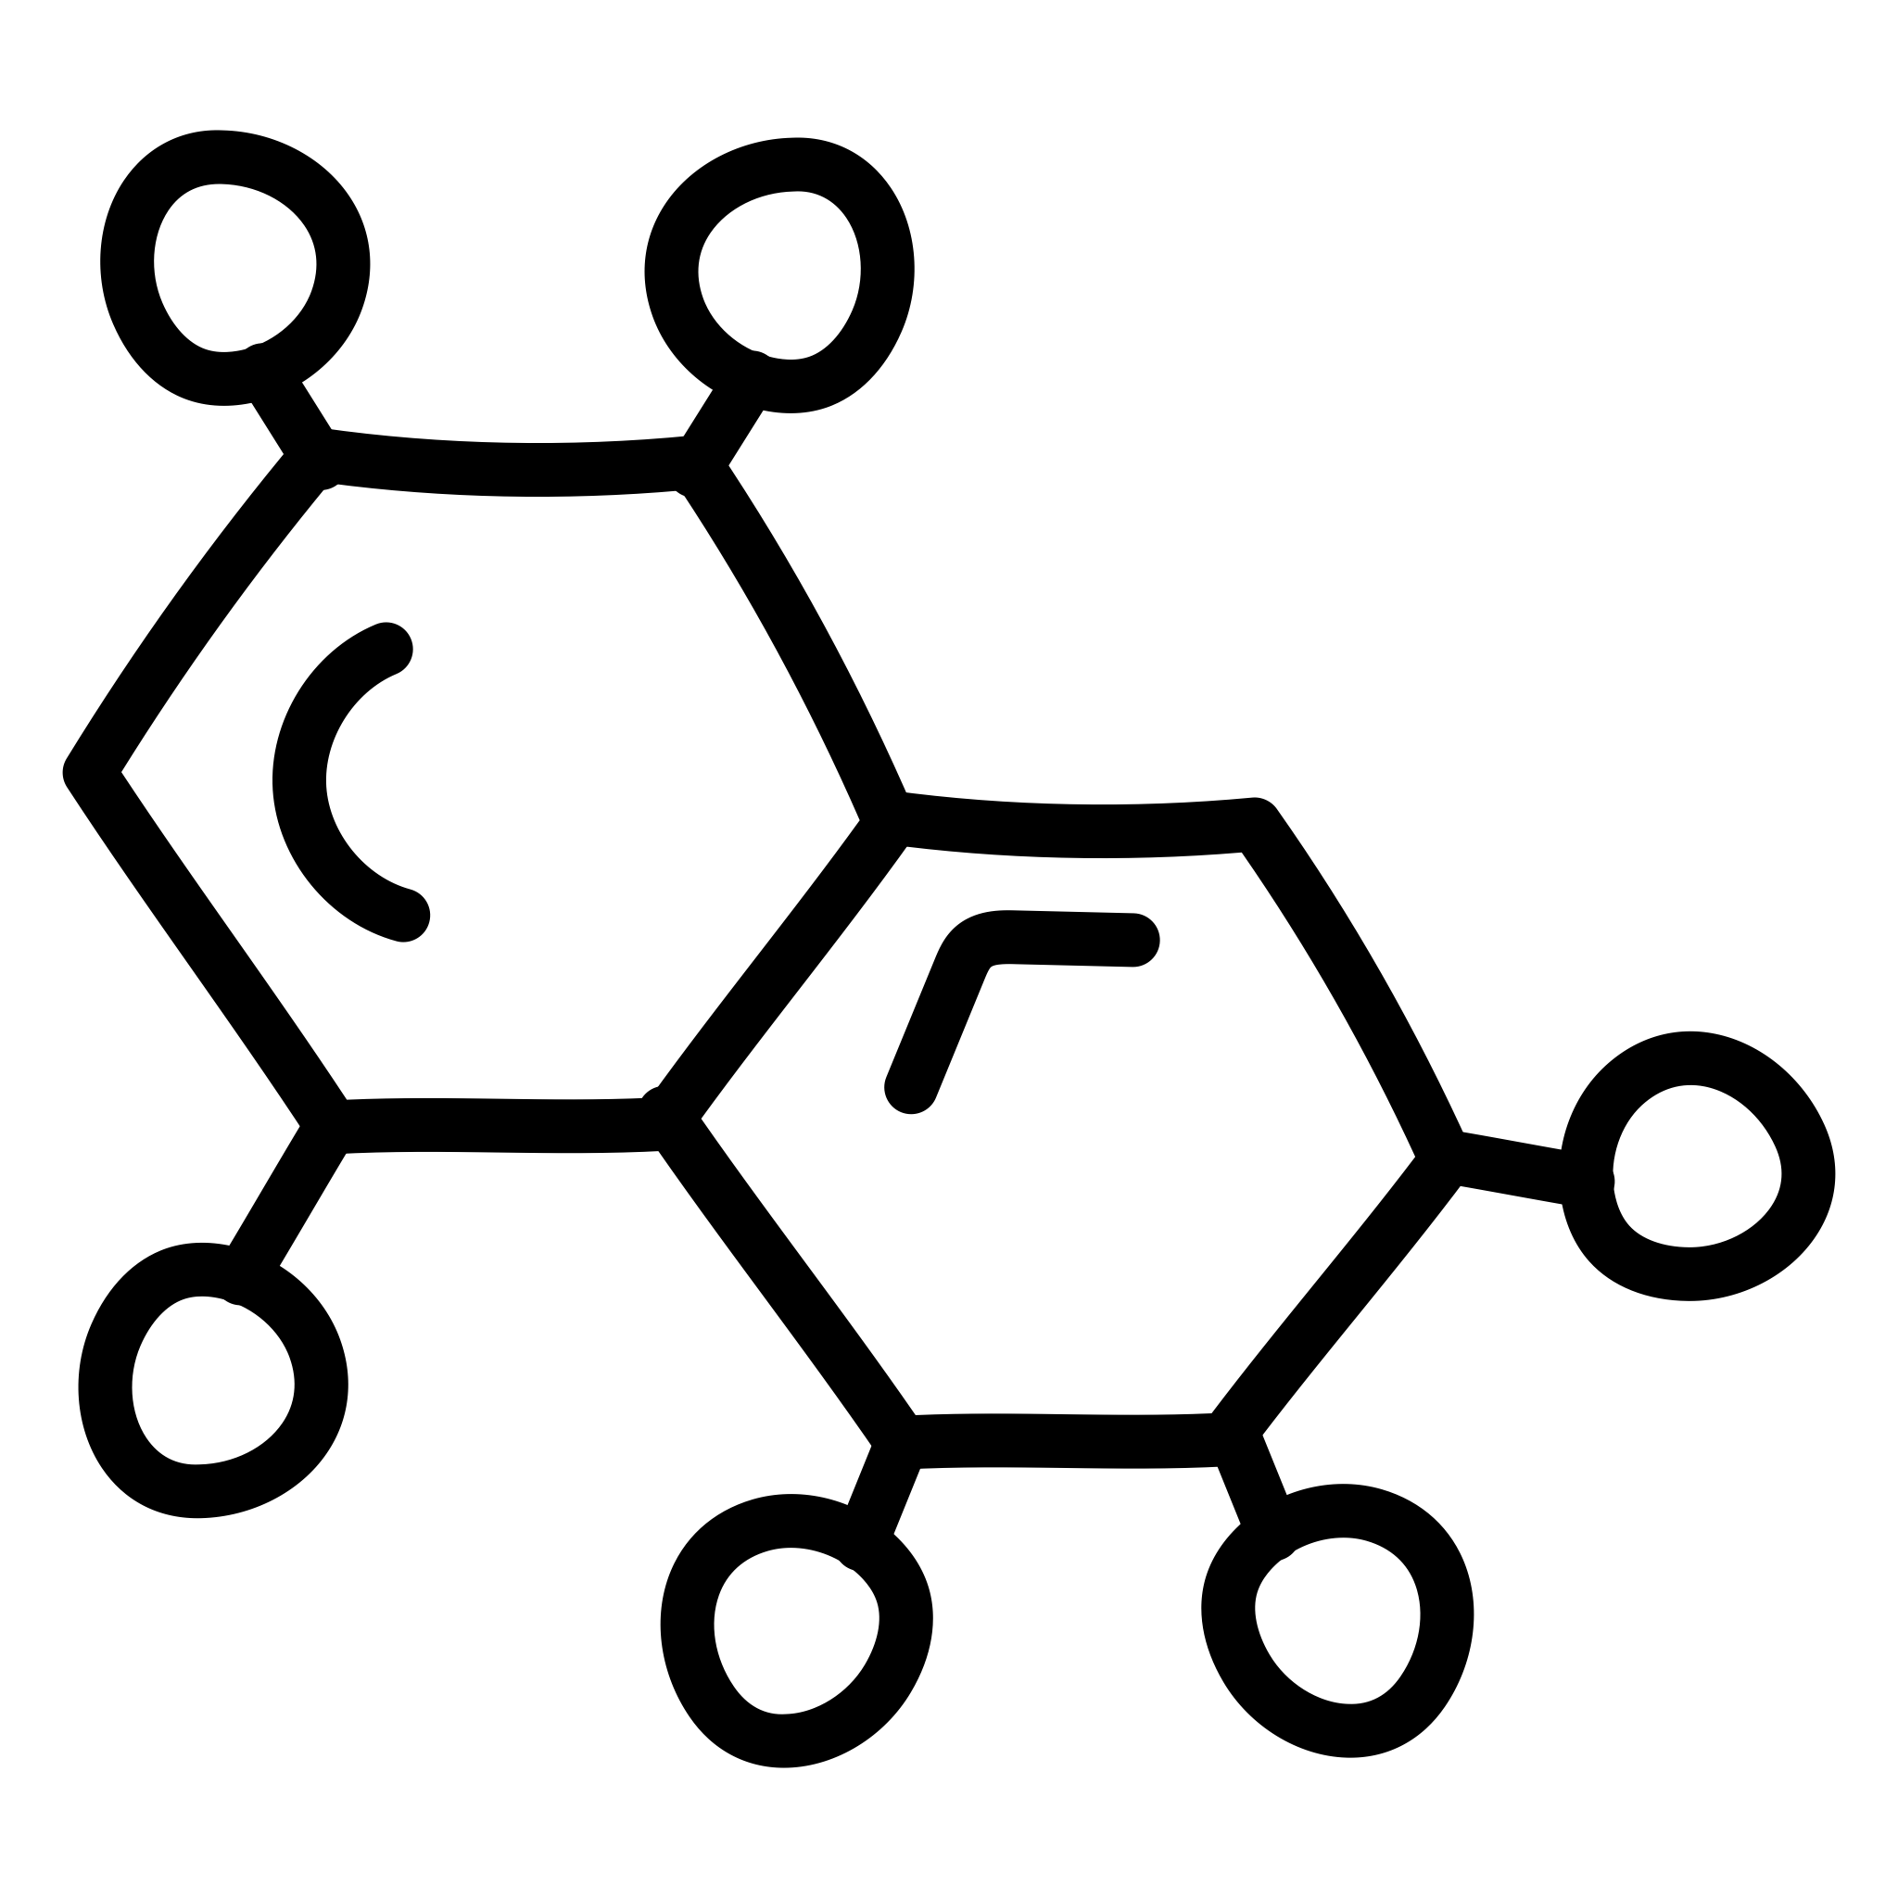
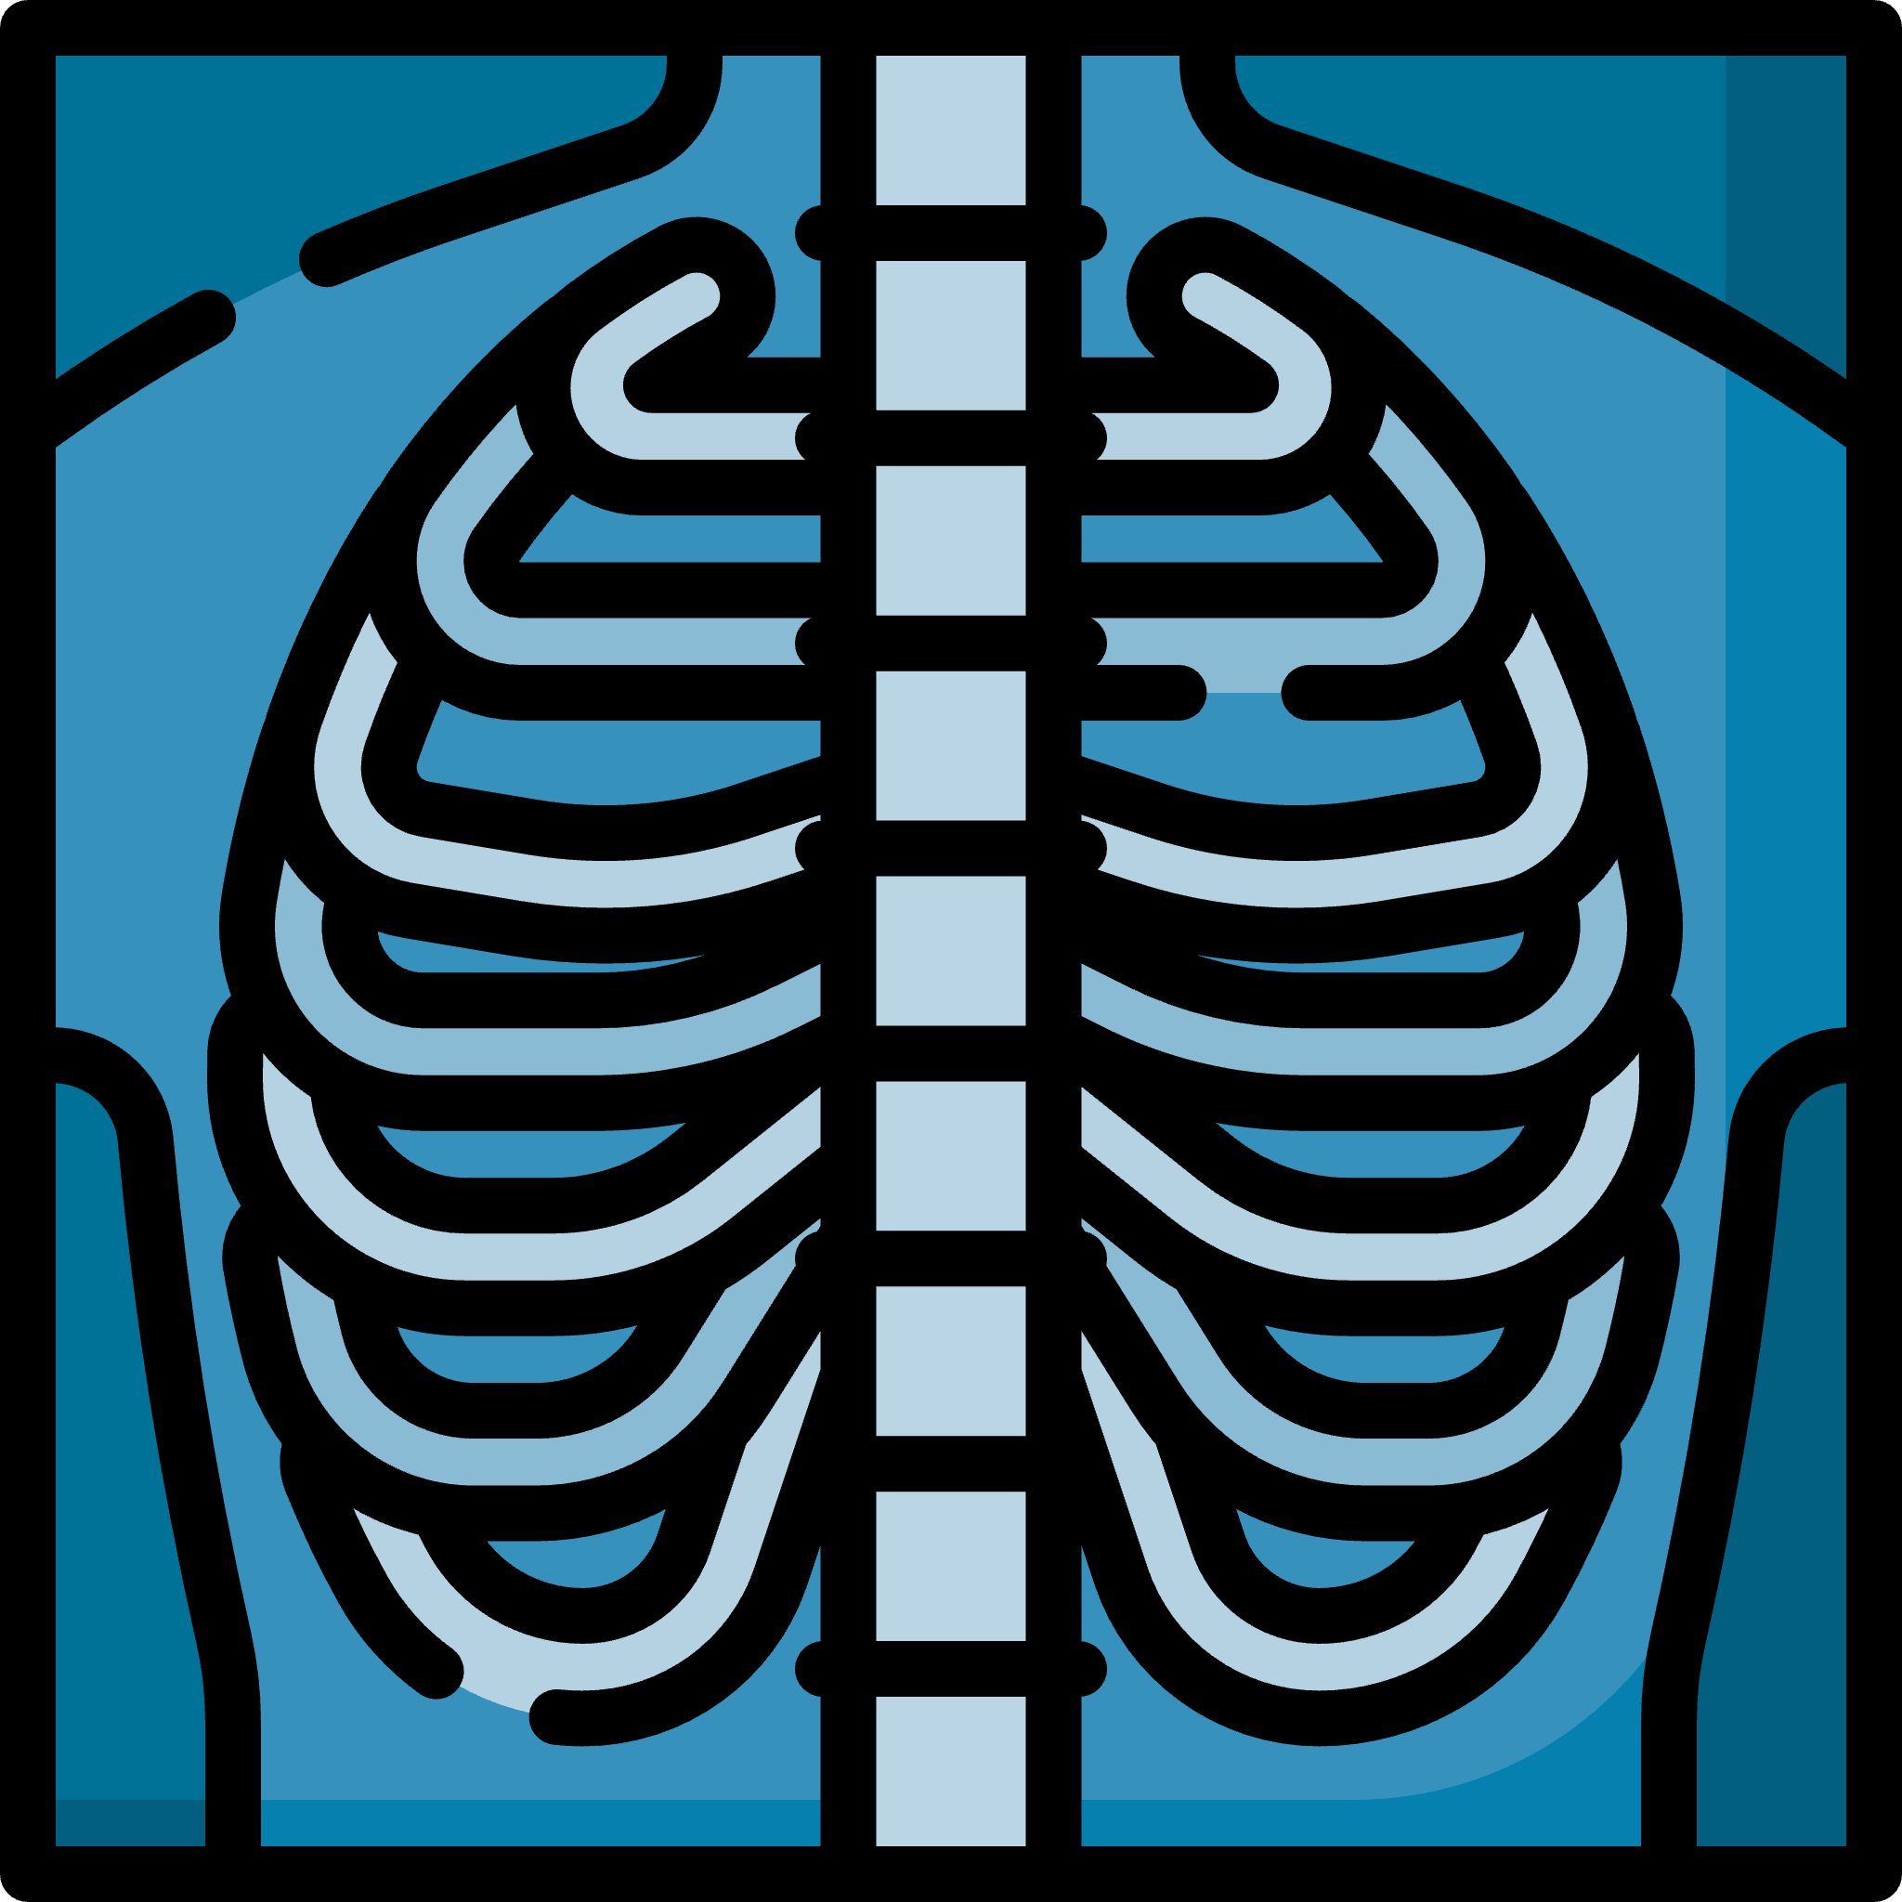


Deep Learning in in Medicine
Drug Discovery
Medical Imaging,
e.g. Radiology, Pathology, Dermatology
Application Areas
Disease Management,
e.g. Chronic Disease, Mental Disease
Diagnosis and Triage
Decision Support / Personalized Medicine
Robotics and Surgery
Virtual Health Assistants
Data Structuring

Slide 4
Why Machine Learning is not enough sometimes…
Feature 1
Feature 2
Feature 3
Raw/ unstructured data
Unknown features
Manual labour
Complex interactions
Pat. 1
21
7
8
Artificial Intelligence
Pat. 2
5
35
9
Machine Learning
Pat. 3
87
58
3
Deep Learning
Gen AI
Deep learning can be used to model non-linear relations

Slide 5






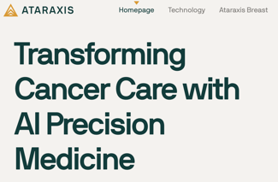

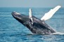

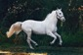


History of DL
1986
Rumelhart, Hinton, Williams invent backpropagation algorithm
1943
2012
McCulloch & Pitts
first artificial neuron
1980
Fukishima’s Neocognition
GPU acceleration
1969
Minsky & Papert “Perceptron” book
Deep Learning Winter
Deep Learning revival
Rosenblatt’s perceptron
Transformer Neural Networks
ImageNet
1958
LeCun engineers Convolutional Neural Networks
2017
2009
2024
1989
Images from https://unsplash.com/, https://flaticon.com

Slide 6
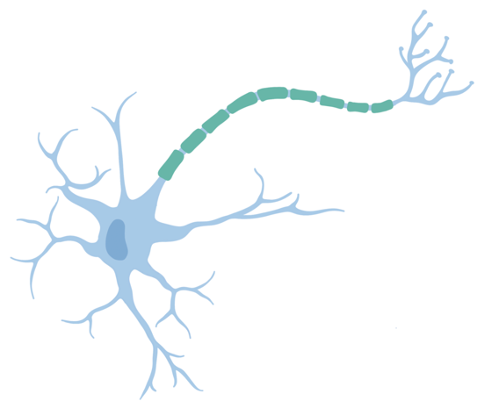
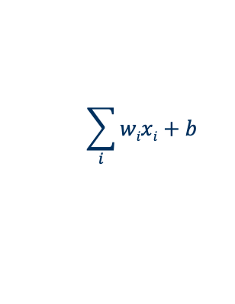
Basics of Neural Networks
1
signal transduction
x₁
w₁
2
signal in
synapse
x₂
w₂
$$\sum_{i}{wixi+b}$$
signal to next cell
Activation function
output
dendrites
3
x₃
w₃
x_{i}
w_{i}
1
2
3
Activation functions:
1
1
Activation functions introduce non-linearity to neural networks
-
0
+
-
0
+
-
0
+
Sigmoid
Tanh
ReLu

Slide 7
Deep Neural Networks
Dense / fully connected layer
Sparse layer
Artificial neurons can be stacked together in various ways
Output
Output
Input layer
Input layer
Hidden layer
Hidden layer
Hidden layer
Hidden layer

Slide 8
Convolutional Neural Networks
Convolution:
2
2
0
0
0
0
0
0
3
1
-1
-3
0
1
1
1
1
0
4
2
-3
-3
0
0
1
1
0
0
4
2
1
1
0
0
1
0
0
0
-1
0
1
3
0
-1
-2
0
1
1
1
1
0
-2
1
2
0
0
0
0
0
0
-1
0
1
Filters detect structures within the image matrix
Pooling:
3
1
-1
-3
Pooling reduces spatial size
Makes features more robust to variation
1
3
3
1
4
2
-3
-3
4
-1
-2
-2
-3
-3
0
-0.25
4
2
1
1
Max. pooling
4
1
2
1
1
2
Mean. pooling
0
0.25
3
0
-1
-2
-1
-2
-1
0

Slide 9
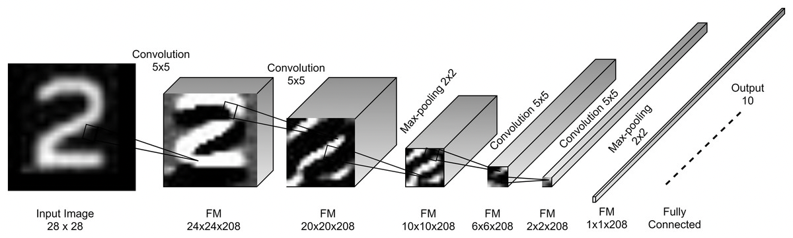
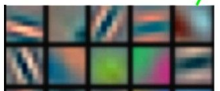
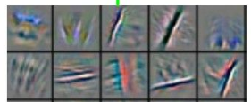
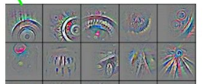
Convolutional Neural Networks
output
Small-level features
Middle-level features
High-level features
classifier

Slide 10
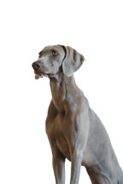
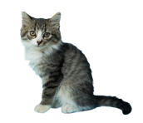


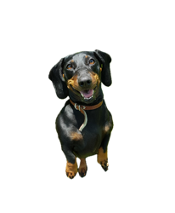





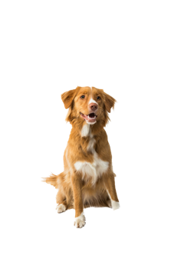
The Latent Space
Cats
Dogs
classification
regression
reconstruction
Input Space
Latent Space
Images from https://unsplash.com/

Slide 11
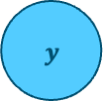
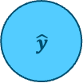
How do Neural Networks learn ?
$$\hat{y}$$
$$y$$
Error: difference between prediction and output
Error is sent back through all neurons
Gradient of error is calculated for each weight
Weights are updated in regard to error
New error is sent back …
1
2
3
4
5

Slide 12
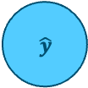
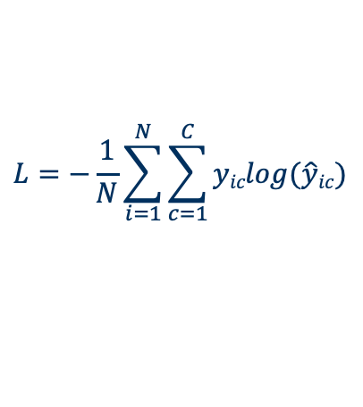
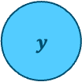
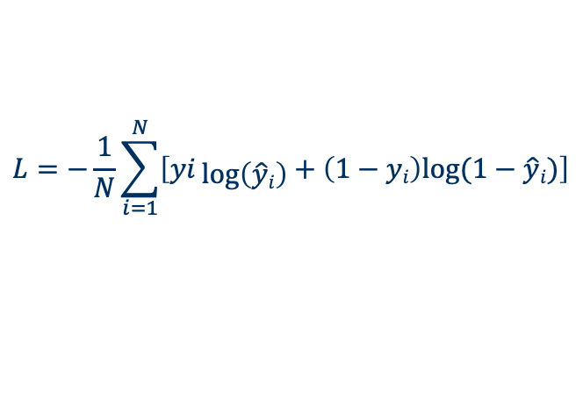
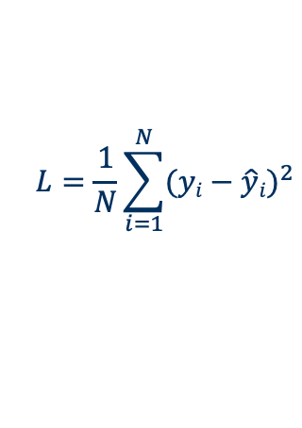
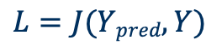
How do Neural Networks learn ?
Loss Function
We want to minimize loss function and with this decrease the error between prediction and label.
$$L=J(Ypred, Y)$$
$$\hat{y}$$
$$y$$
Loss Function for Regression
Loss Binary Classification
Loss Multi-Class Classification
$$L=\frac{1}{N}\sum_{i=1}^{N}{{(yi−\hat{y}i)}^{2}}$$
$$L=−\frac{1}{N}\sum_{i=1}^{N}{\left[yi\log\left(\hat{y}i\right)+\left(1−yi\right)log⁡(1−\hat{y}i)\right]}$$
$$L=−\frac{1}{N}\sum_{i=1}^{N}{\sum_{c=1}^{C}{yiclog(\hat{y}ic)}}$$

Slide 13
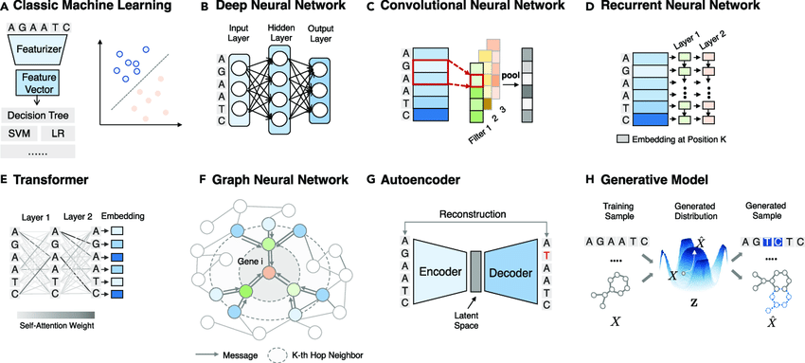
Todays Diversity
https://www.cell.com/patterns/fulltext/S2666-3899(21)00176-8?_returnURL=https%3A%2F%2Flinkinghub.elsevier.com%2Fretrieve%2Fpii%2FS2666389921001768%3Fshowall%3Dtrue

Slide 14
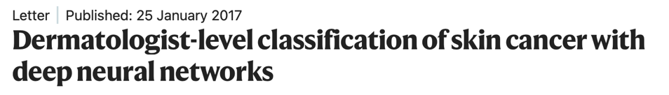
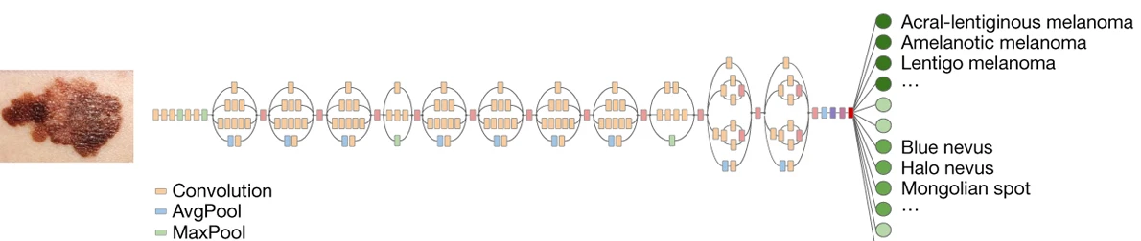
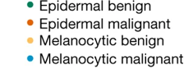
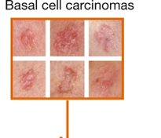
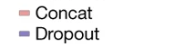
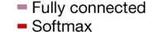
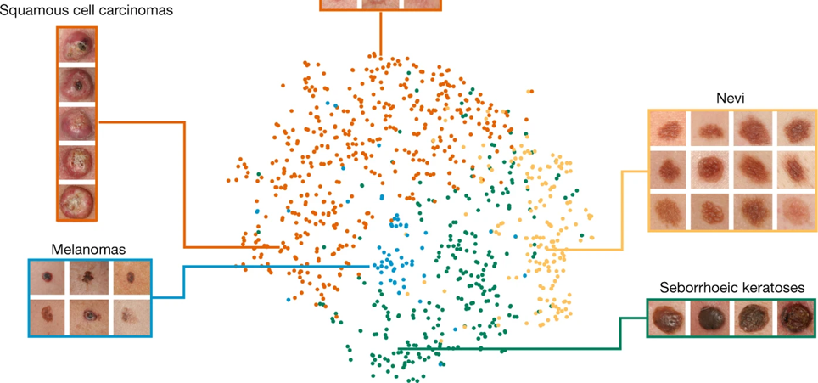
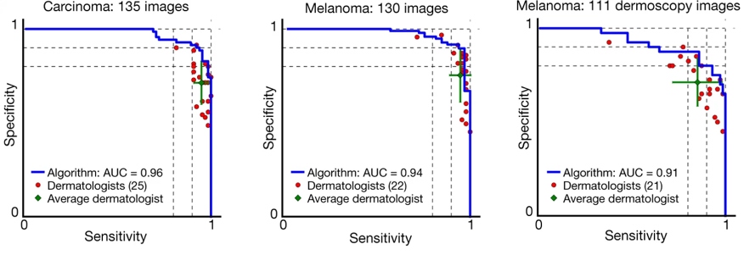
Example - Melanomas
https://doi.org/10.1038/nature21056

Slide 15
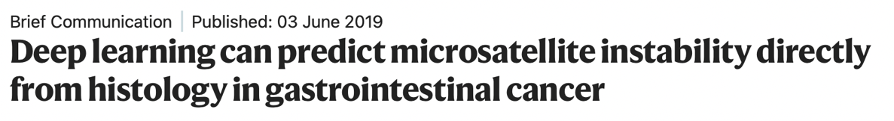
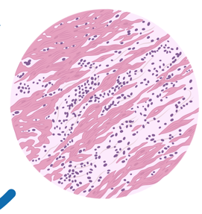
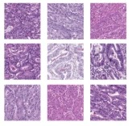
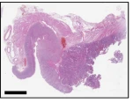
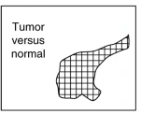
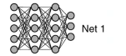
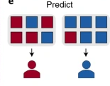
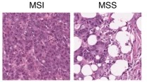
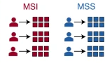

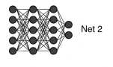
Example - Pathology
Step 1
Step 2
https://doi.org/10.1038/s41591-019-0462-y

Slide 16
Challenges and Limitations
Data Challenges
Model Challenges
Clinical Challenges
Bias in training data
Imbalance of training data
Data availability / open-access
Artefacts
Digitization
Explainability
Decisions aligned with newest clinical guidelines
Compute
Size
Safe use in best interest of patients
Performance degradation over time / domain shift
Compliance with regulatory standards
Easy and accessible use

Slide 17
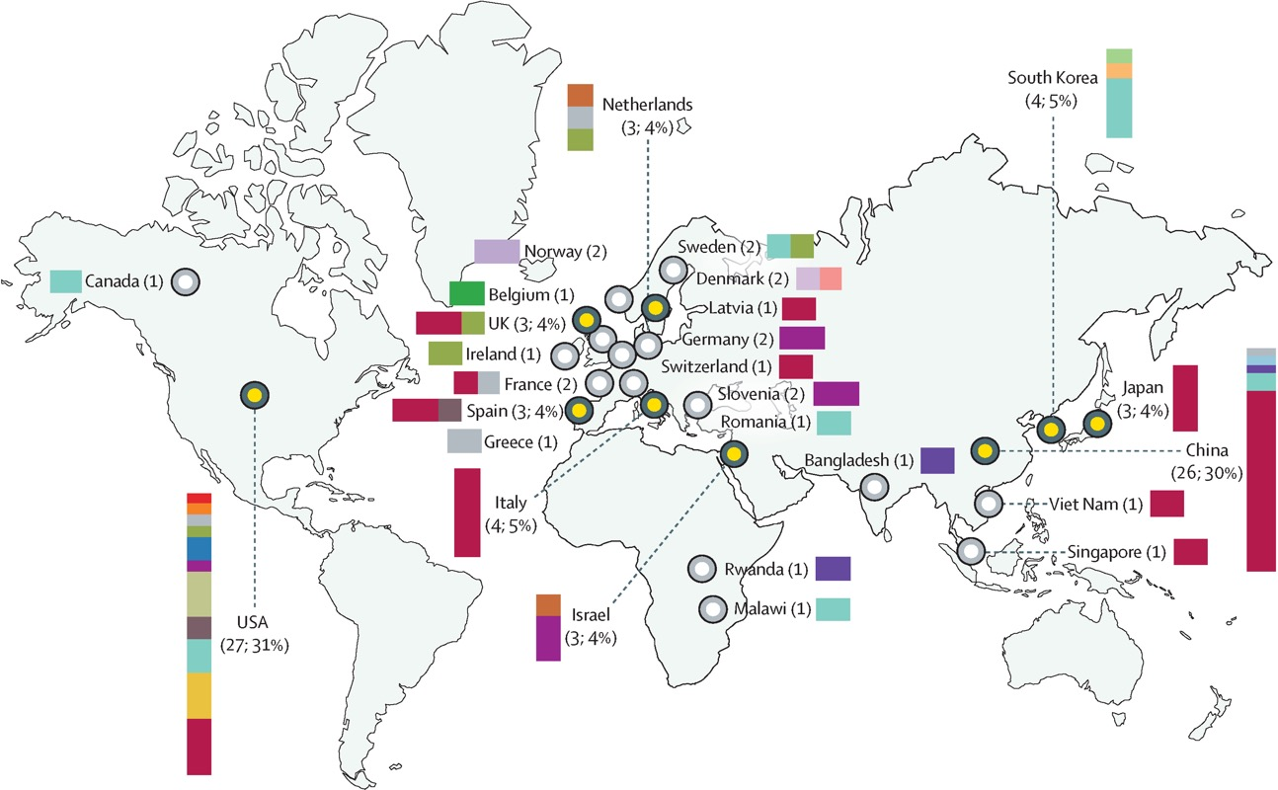
Clinical Trials
https://www.thelancet.com/journals/landig/article/PIIS2589-7500(24)00047-5

Slide 18
Any questions or remarks?
Let’s practice – Deep Learning Basics on Jupyter Hub

